Slide 1
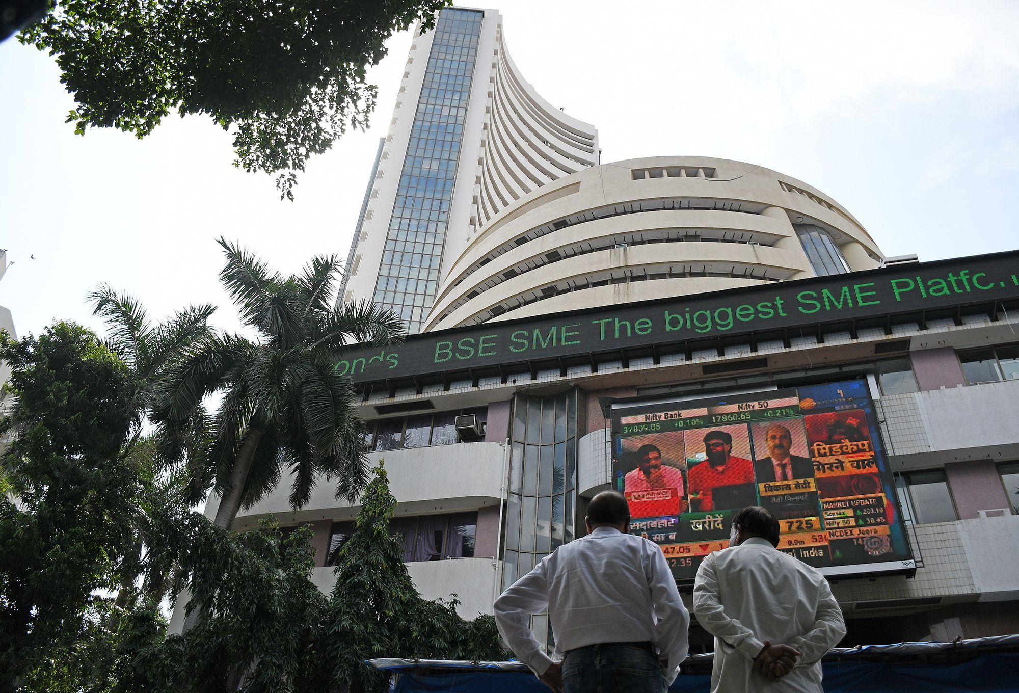

Dormant Giant: India Emerging as the Next Prime Investment
Parker Rollins and Jay Sampat
Notes:
P

Slide 2



Gaining Momentum
GDP is positively correlated with stock market
“Prime investment destination for the next decade”
Article Prediction: “If you believe the economy is poised to grow to about $8 trillion-plus by this time in the next decade, the volatility is worth it.”
Predict GDP -> Predict stock market -> Capture future returns
Notes:
J

Slide 3
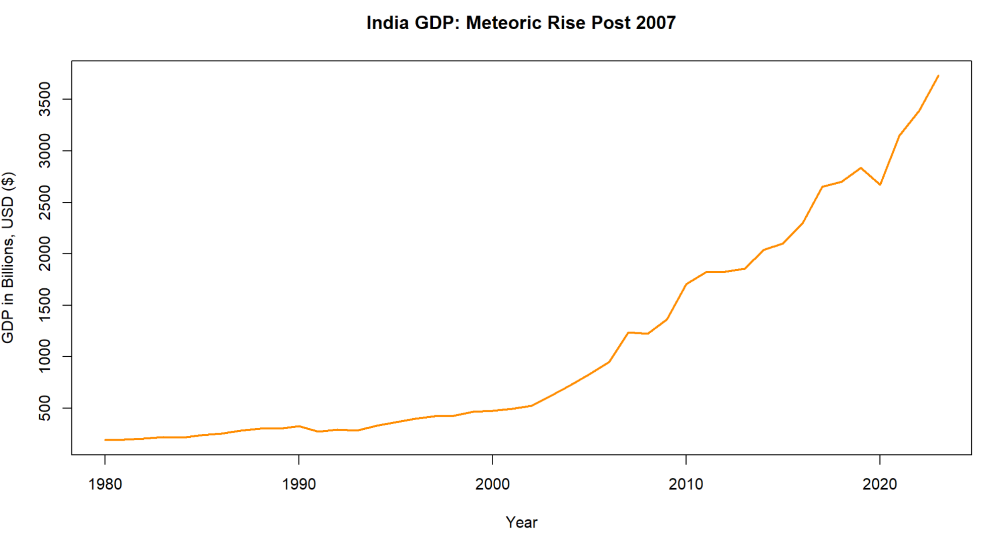
Exploratory Data Analysis (EDA)
Notes:
P

Slide 4

Project Purpose and Objectives
Purpose: Figure out if India is an actual investment opportunity. How aggressively should we hone in on India?
Objective: Build a Robust Model to Predict Past Years’ GDP. If strong enough, extrapolate to get GDP estimates for 2024-2029
Dataset Source: International Monetary Fund (IMF)
Annual GDP Data in Billions USD ($) from 1980-2023 (44 observations, 2 columns)
Notes:
P

Slide 5
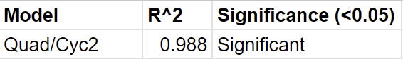
Time-Series Decomposition - 2019 used as Example
First tested Linear, then Quadratic, then Cubic, then Cyclical
Found the strongest (R²) and added on to that
Best Model: R², the components, and their significance
Signal + Random Noise
Notes:
J

Slide 6
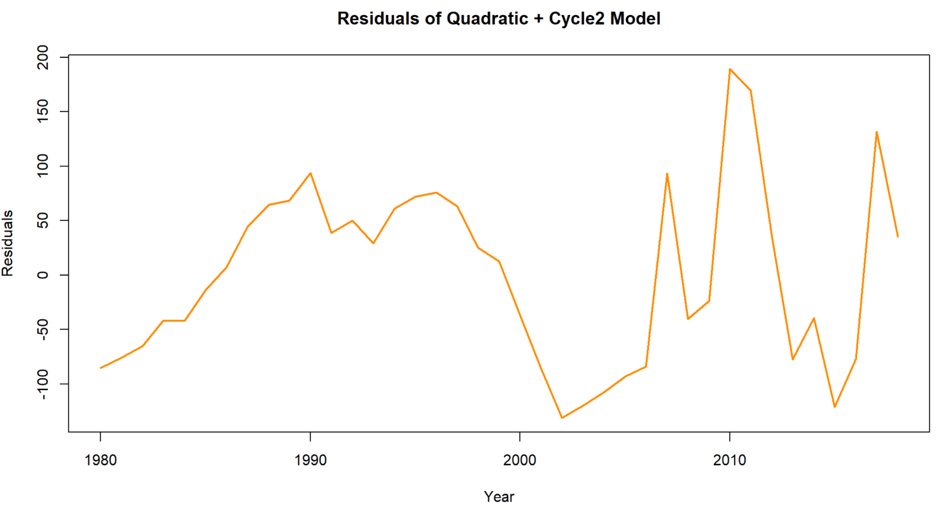
Notes:
J

Slide 7
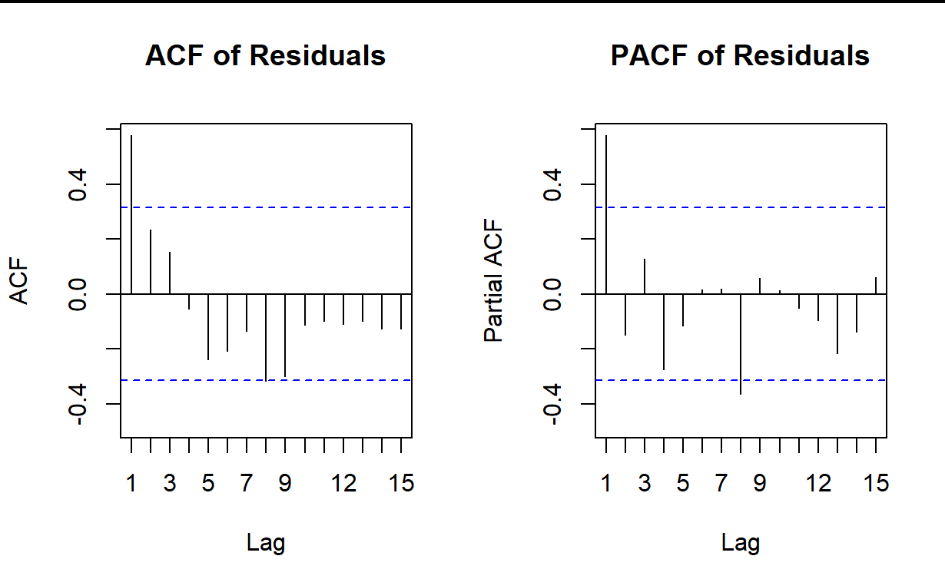
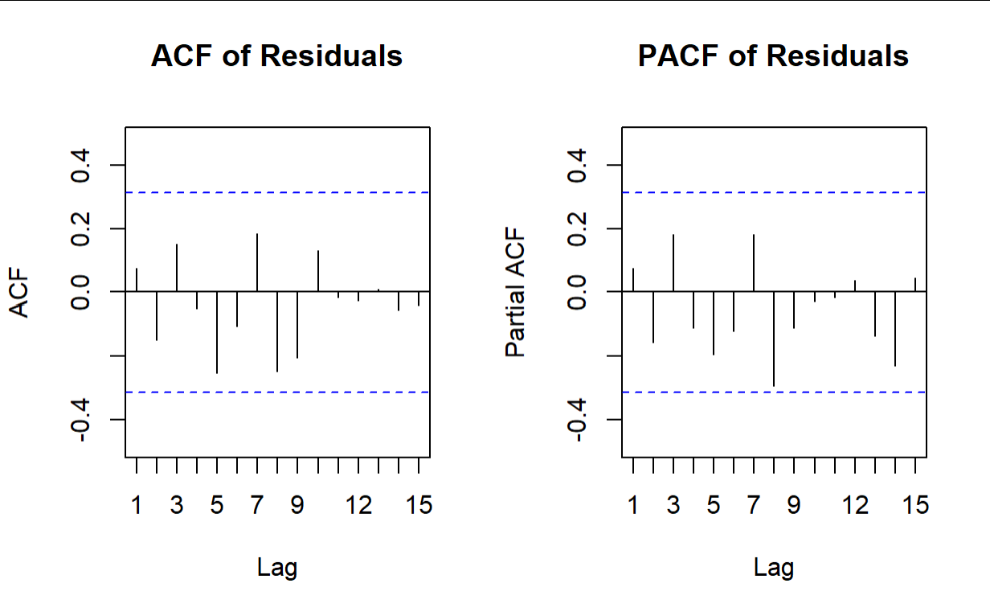
Model Selection
lag | Autocorrelation | D-W Statistic | p-value
1 | 0.58 | 0.81 | 0.018
ARIMA
Durbin-Watson Test indicated Evidence of Positive Autocorrelation in Residuals at Lag 1; Significant at the 0.05 level
Before: AR(1), AR(8), MA(1), and MA(8)
All Components Removed after ARIMA
Notes:
P

Slide 8
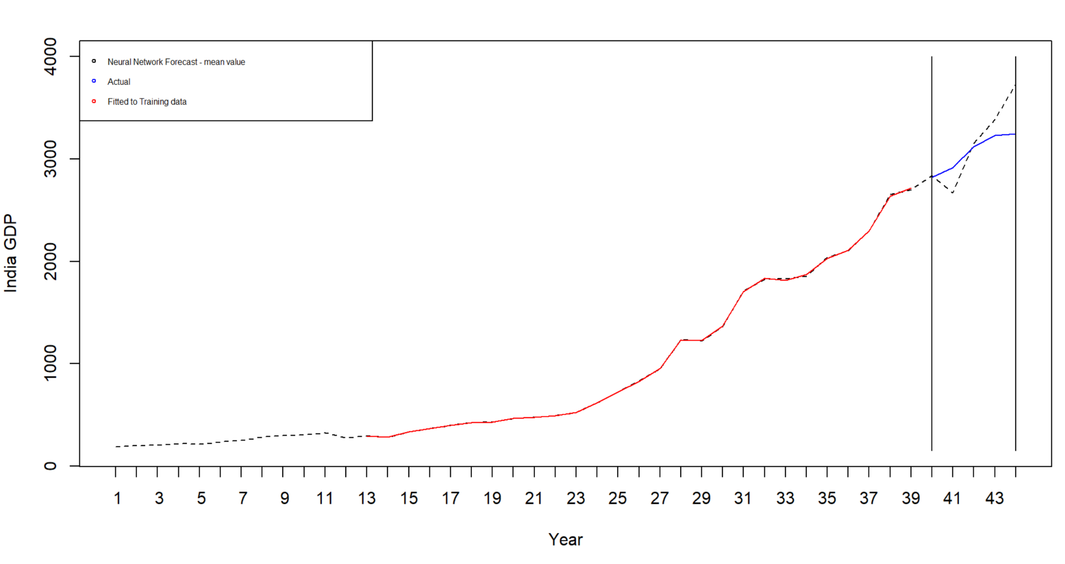
Model Fitting and Assessment
Nnet_actual_MAPE = 0.058
Notes:
P

Slide 9
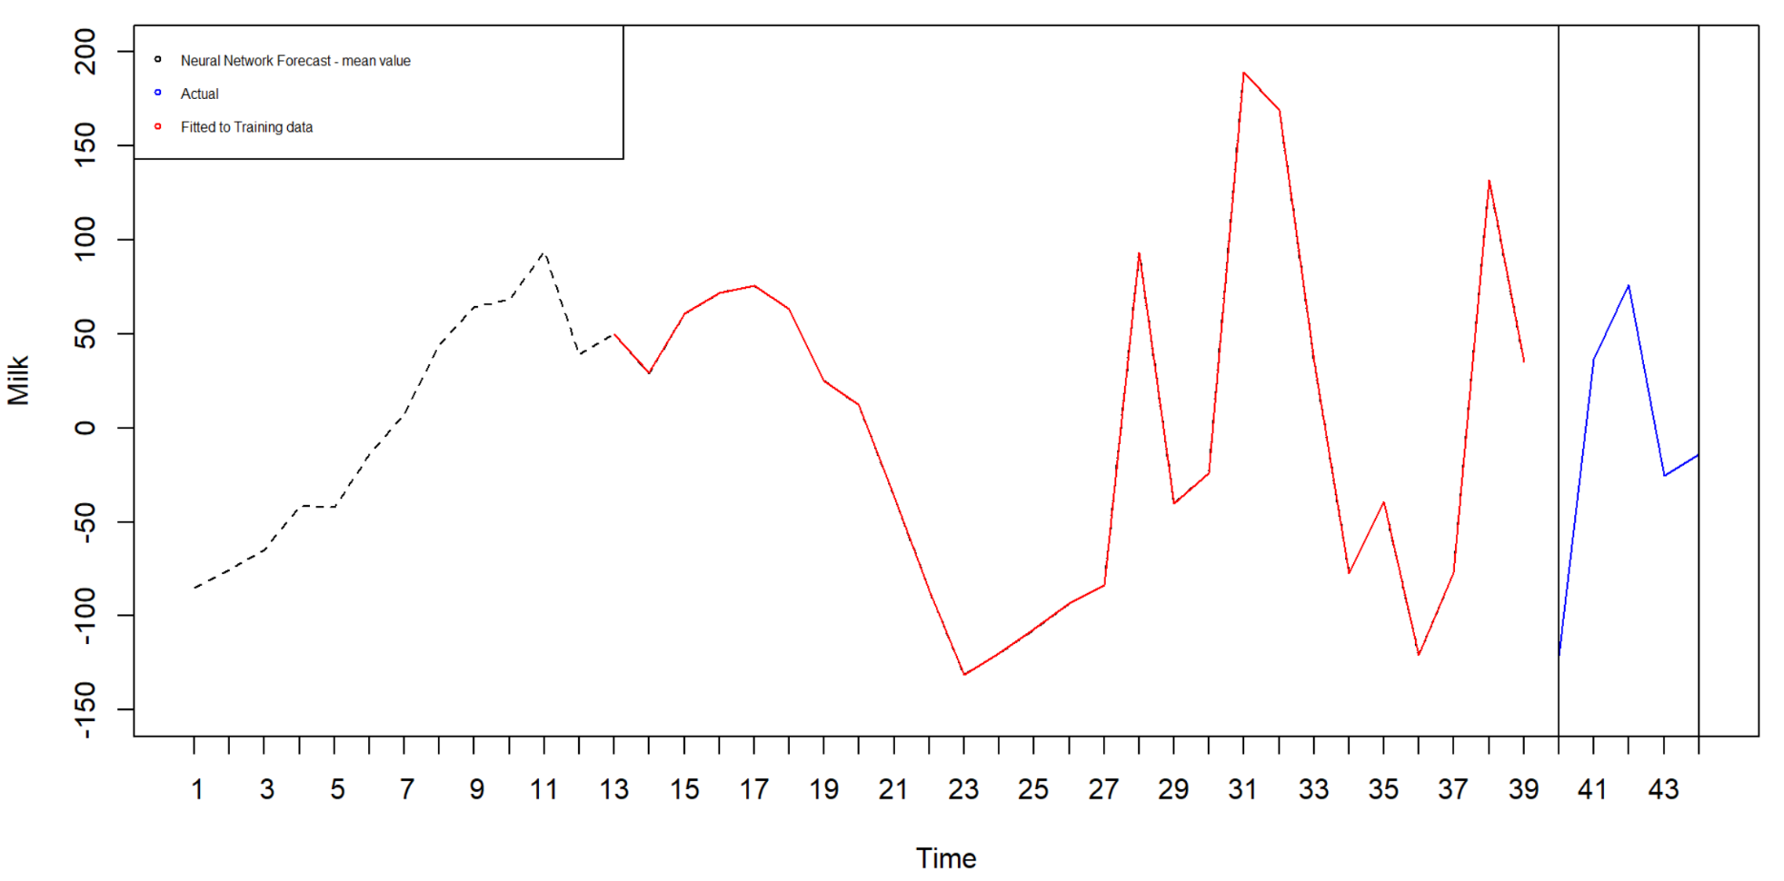
Model Fitting and Assessment
Nnet_DT_MAPE = 1.003
Notes:
P

Slide 10
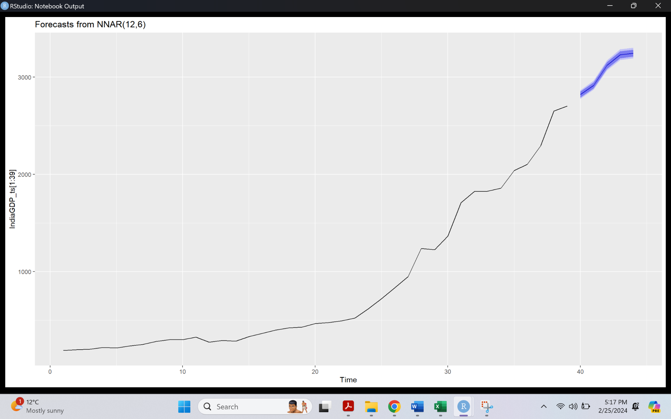
Model Selection Continued - Neural Network
Training: 39 periods (ending in 2019), Validation: 5 periods (ending in 2023)
Notes:
J

Slide 11
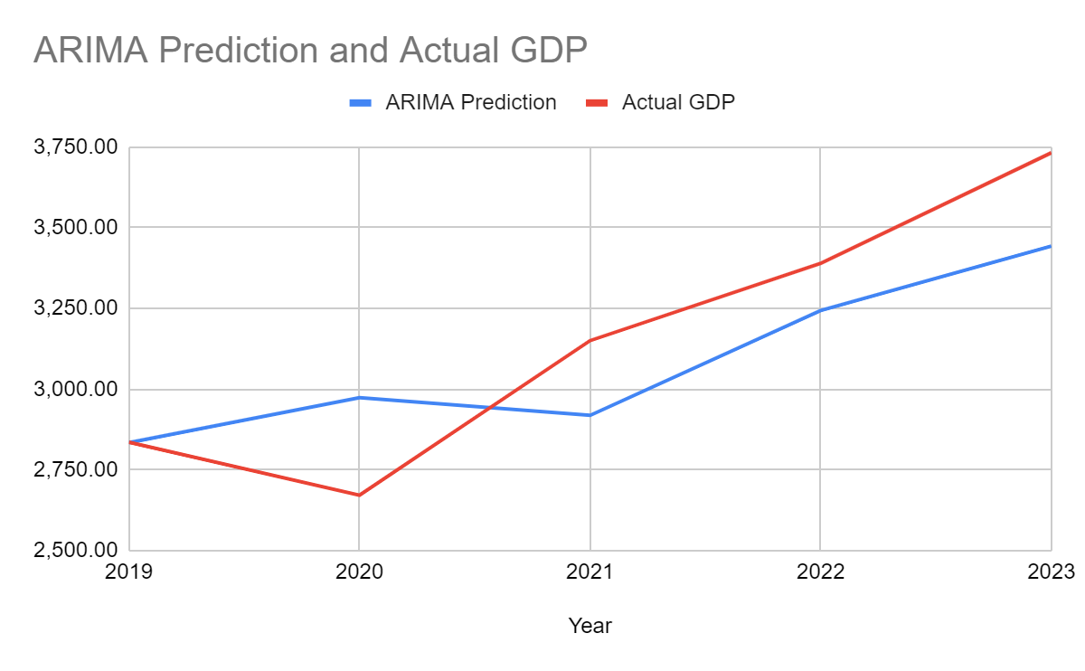
Actionable Insights and Recommendations
Overfitting a concern with our model
India’s GDP is growing
Long term investment plan - NOT an immediate spike / short-term investment
Notes:
P

Slide 12
Next Steps / Other Considerations
Forecasting GDP on historical GDP - not efficient method [Cite IIIM Study]
Applying our model to a longer-term forecast
GDP has other factors that influence its growth
Population
Education
Infrastructure
Investment (Direct Internal)
ARMAX model to test exogenous factors
Notes:
J

Slide 13
Dormant Giant: India Emerging as the Next Prime Investment Parker Rollins & Jay Sampat
Concept
Approach
Determine if India is a true investment opportunity by forecasting its past and potentially longer-term GDP. How aggressively should we hone in on India so we can can capture financial returns?
Partition Dataset, then Detrend using tslm
Find Highest R² Model
Build ARIMA, Remove AR, MA Components
Forecast with Neural Network
Assess Results for Each Year
Forecast / Results
Business Insights
MAPE = 0.058
India’s GDP is growing
Long term investment plan - not an immediate spike
Notes:
J

Slide 14


Notes:
J

